Slide 1
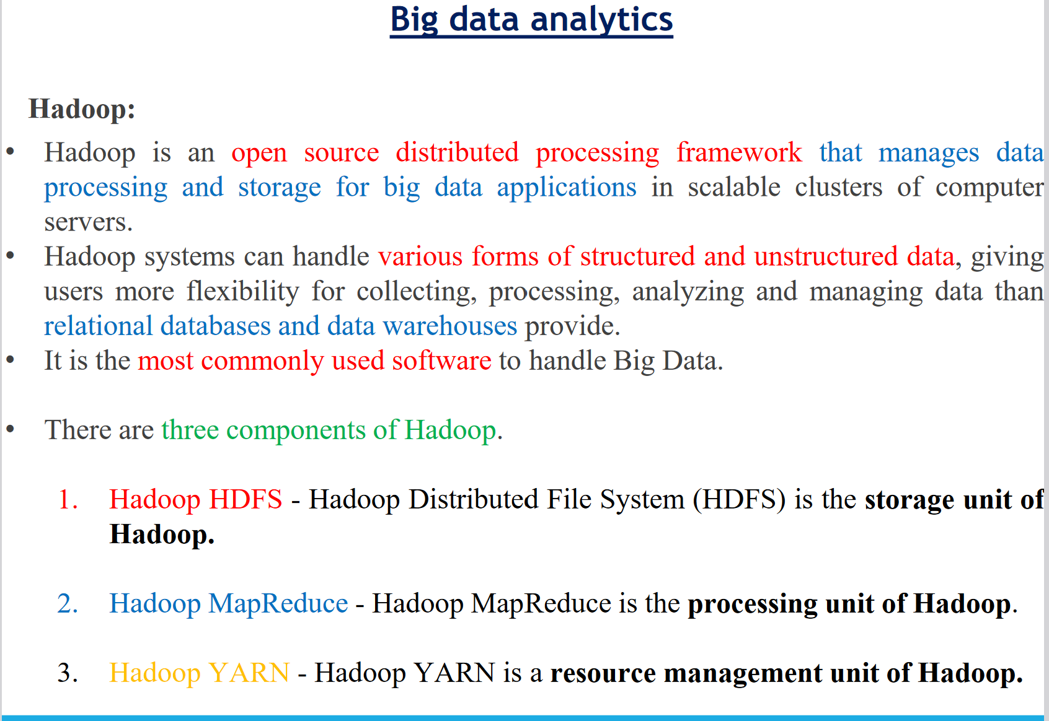
Hadoop’s Parallel World

Slide 2
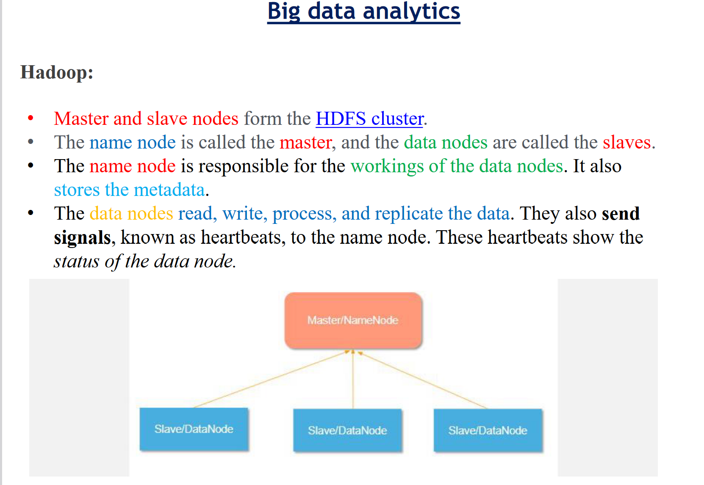
Hadoop’s Parallel World

Slide 3
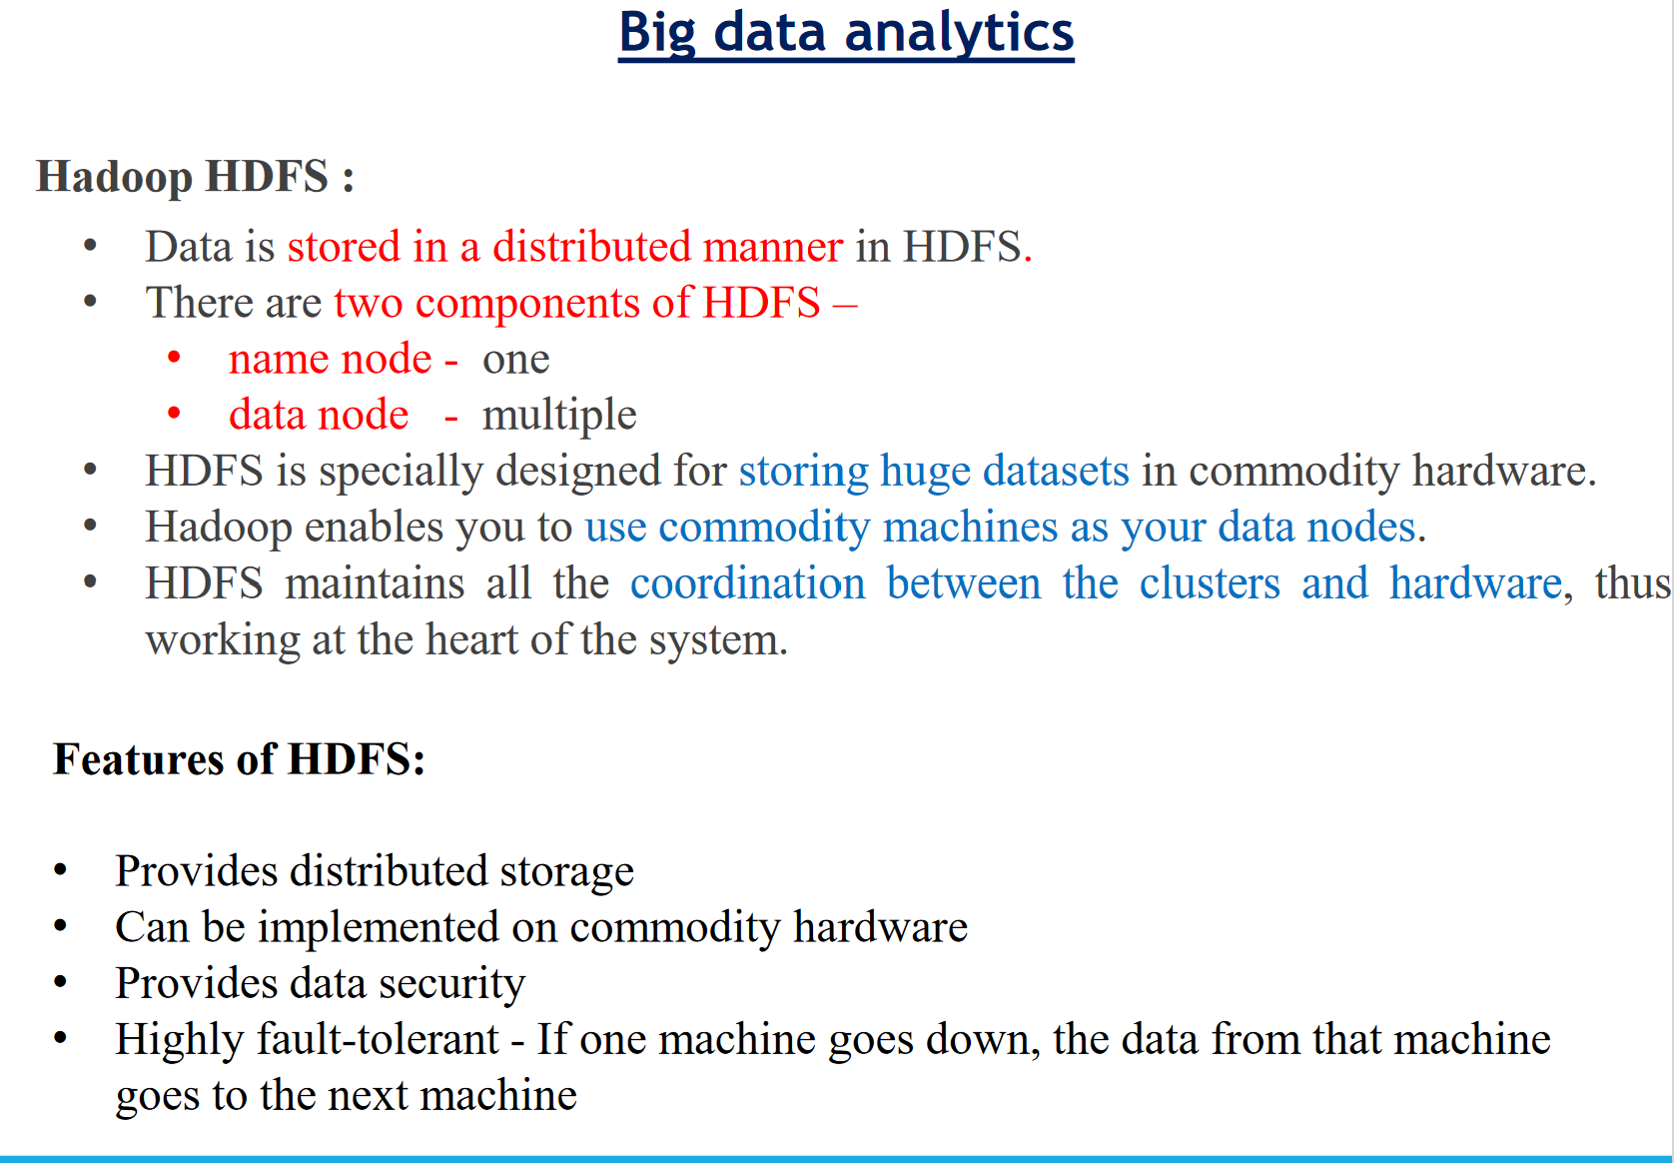
Hadoop’s Parallel World

Slide 4
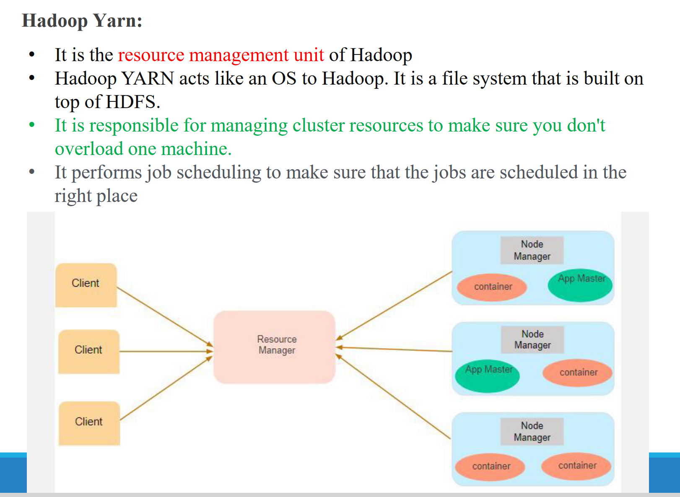
Hadoop’s Parallel World

Slide 5
Data Discovery
Data discovery is the process of navigating or applying advanced analytics to data to detect informative patterns that would not have been discovered otherwise.
Crucially, data discovery does not require business leaders and their teams to build elaborate models. Most companies use data discovery as part of their business intelligence (BI) software, which provides them with a complete view of their organizations in a simple dashboard or visual format.
Data discovery is a process of exploring data through visual tools that can help non-technical business leaders find new patterns and outliers to help an organization better understand the insights their data has to offer.
As a result, employees in every department can make smart business decisions and, just as importantly, continuously refine their approach. Whether seeking new efficiencies in warehouse processes or better ways to personalize social media activity, data discovery helps organizations uncover the nuggets of wisdom that turn their business intelligence into a dynamic and differentiating business asset.
https://www.heavy.ai/technical-glossary/data-discovery
https://www.netsuite.com/portal/resource/articles/erp/data-discovery.shtml

Slide 6
How Is Data Discovered?
Data discovery is a five-step process. It is also an iterative process, which means companies can continue to collect, analyze and refine their data discovery approach over time by drawing on their results and feedback from business stakeholders.
Step 1: Identify needs. Effective data discovery begins with a clear purpose, such as the resolution of a pain point. This means considering what kinds of data would be helpful to know, while remaining open to the unexpected insight along the way. For instance, a distributor of fast-moving consumer goods (FMCG) might decide to re-examine its logistics data in an effort to reduce food waste during shipment by 10%. Or a retail bank might analyze its web data with the aim of reducing bounce rates for new prospects.
Notes:
Retail banks are for the general public to help them save and invest their money and handle their regular needs by providing various services like bank accounts, credit cards, debit cards, fixed deposits, loans, and many more.

Slide 7
How Is Data Discovered?
Step 2: Combine data from relevant sources. For data discovery to be effective, it is important to combine and integrate data from multiple sources because no single data stream tells the complete story. This process is sometimes referred to as data crunching.
Step 3: Cleanse and prep the data. This is the heavy lifting part of data discovery — and a key part of its value. Cleaning the data and preparing it for analysis helps organizations reduce the “noise” in their data and get clearer direction from their data analyses.

Slide 8
How Is Data Discovered?
Step 4: Analyze the data. With information combined from multiple departments, integrated with external data and cleansed for analysis, business leaders can gain a complete view of their operations and solve the operational riddles that stand in the way of efficiency.
Step 5: Record learnings and iterate. Data discovery is not a one-off process; it is a commitment to continuous improvement. In the bestseller book Outliers, author Malcolm Gladwell said it takes people 10,000 hours of practice to master a particular skill — and the same is true of businesses learning to master their data. They must treat data discovery as a way of life with the aim of improving and running more efficiently over time.

Slide 9
Processes for Data Discovery
Businesses collect enormous volumes of data about their customers and suppliers, in addition to data about their own operations. Moreover, they need to combine data streams from a mix of online and traditional systems from different channels such as mobile phones and tablets and from platforms like Facebook and other social networks.
Data discovery processes allow organizations to connect data from all of these sources, prepare it for analysis, share it among their internal teams and support crucial decision-making with valuable data-driven insight. Today, the emergence of artificial intelligence (AI) has added a new layer of sophistication to data discovery.
Whether using manual or advanced data discovery techniques, the process generally includes five steps — with continuous iteration.
Understand what data is needed for the business analysis in question.
Researchers must locate data sources that will provide that data.
With all the necessary data located, set up a search query.
Based on initial results, your data team will more deeply scrutinize the relevance of the data sources, eliminating irrelevant data and refining search queries accordingly.
Researchers can evaluate the quality of their results and continue to reiterate these steps until they’re confident they have sound answers.

Slide 10
Data Discovery Explanation?
Data discovery uses diagrams, text and visual storytelling to explain trends and convey other types of information. This means non-IT staff can understand large volumes of complex data and quickly extract the insight they need. In this way, data discovery democratizes data analysis for every employee.

Slide 11
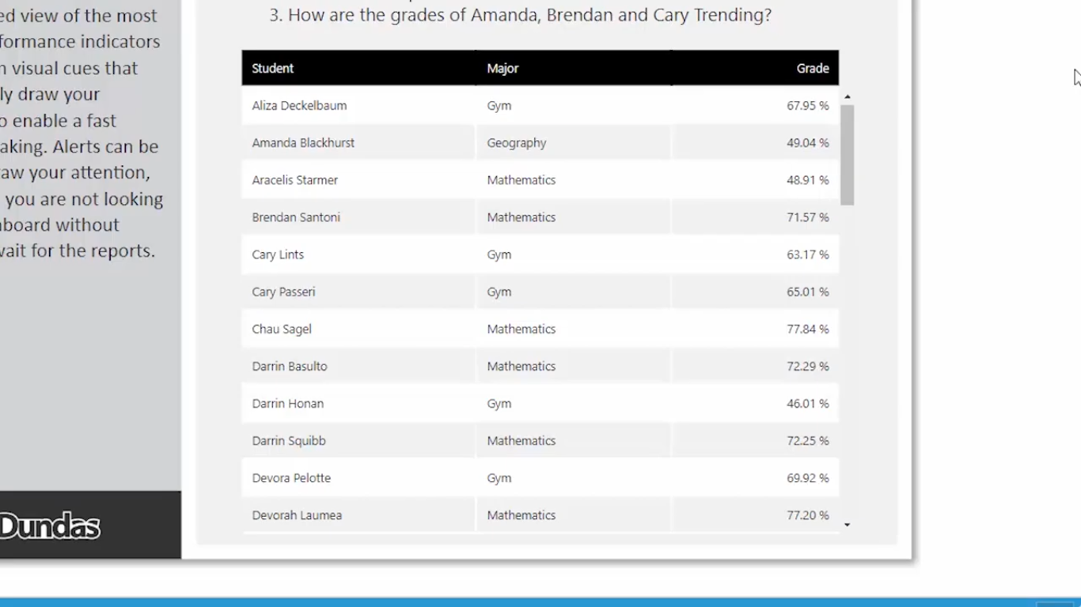
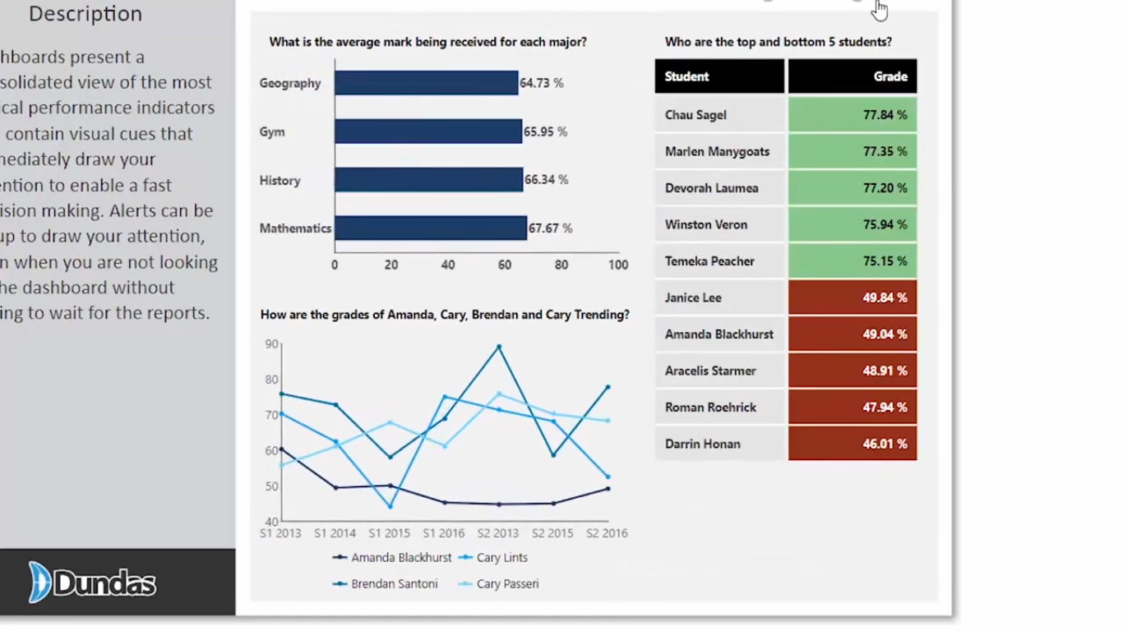

Slide 12
Data Discovery Categories
The three main categories of visual data discovery include data preparation, data visualization, and advanced analytics and reporting:
Data Preparation: This preprocessing step uses statistical techniques to merge raw data from disparate sources, then clean, transform, and eliminate noise from the data so that quality is consistent and formatting is usable.
Data Visualization: The human brain instantly recognizes patterns and relationships in visualizations. Data visualization is a critical process for analyzing big data, in which important insights and messages would otherwise be lost, and for displaying the results of machine learning and predictive analytics.
For example, design teams can easily learn how customers are using their products and adapt their work accordingly. And finance teams can get a snapshot of cost versus revenue for every department in the business and pinpoint areas for improvement.
Advanced Analytics and Reporting: Descriptive statistics organizes, summarizes, and breaks down data into a simple, intelligible report that is easy to understand and helps businesses make data-driven decisions.
Notes:
The first step is essential for a quality data discovery process. The data preparation phase rearranges the data so that the visualization and analysis portion of data discovery can run more smoothly.
Without preparation, the data will be too convoluted to properly uncover any hidden business insights. Data preparation essentially cleans and merges the data quality within the datasets being examined.
Today, there are many types of software that provide data preparation in addition to other discovery and classification tools.
These automated tools are able to erase outliers, unify data formats, detect null values, and standardize data quality.
Once all of the data points have been transformed into a consistent and readable format the data then enters the visualization stage. For example, interactive data visualizations, that consist of many predefined templates for dashboard analysis, are one of the features of great data discovery tools.
Visual data discovery, also referred to as data mapping, displays the prepared data into visual formats such as charts, graphs, maps, etc. to provide business experts with broader insights and convenient platforms for visual analysis.
These visual guides, resulting from data mining, data preparation, and sorting, display the primary trends found in the dataset being processed.
Arguably, data visualization is the most important step for data discovery, as it is a foundational aspect of AI-based business intelligence.

Slide 13
Types of Data Discovery
There are two main data discovery processes: Manual and Smart:
Manual Data Discovery: Manual data discovery is the manual management of data by a highly technical, human data steward. Before advancements in machine learning, data specialists would manually map and prioritize data, monitor and categorize metadata, document rules and standards, and conceptualize all available data using critical thinking.
Smart Data Discovery: Smart data discovery solutions provided an automated experience. With the advancement of machine learning, smart data discovery software has been developed, using Artificial Intelligence to automate data preparation, conceptualization, integration, and presentation of hidden patterns and insights through data discovery visualizations.

Slide 14
Benefits of Data Discovery
Data discovery is a subset of business intelligence. It refers to the process of collecting and consolidating data from multiple databases into a single source, where it becomes easier to investigate and detect patterns.
A complete picture of company data: Data discovery provides businesses with a big-picture view of the many data streams in their organizations, allowing them to combine these streams in their analyses and develop well-rounded solutions to their challenges or customer needs. For instance, a retail bank can combine customer data from its website, mobile app, social platforms and ATMs to gain a more accurate view of each person it serves and better understand their behavior.
Democratized insight and decision-making: IT and data expertise should not be a prerequisite to gain business insight. Data discovery makes data analysis understandable for stakeholders across the business, regardless of their data literacy.
For instance, sales teams can see how their strategies drive or stop leads throughout the sales funnel, finance teams can spot and trim excess fat from their organizations’ operating expenses and marketers can tie together data from various customer touchpoints to see how their activities align with sales success. In short, data discovery has nearly limitless applications to match different business teams’ needs.

Slide 15
Benefits of Data Discovery
Automatic data classification based on context: Companies collect more data from more sources and in new formats each day. Data discovery makes it possible to classify all of this information accurately based on the channel, conditions and context in which it is collected. For example, retailers can differentiate between customer data collected by their marketing, sales and service teams to assess their entire customer experience, rather than at a single moment in time.
Notes:
A retailer is a company that buys products from a manufacturer or wholesaler and sells them to end users or customers.

Slide 16
Benefits of Data Discovery
A complete picture of company data: Data discovery provides businesses with a big-picture view of the many data streams in their organizations, allowing them to combine these streams in their analyses and develop well-rounded solutions to their challenges or customer needs. For instance, a retail bank.
Improved risk management and compliance: As data volumes grow and governments become more invested in data protection, risk management and compliance have moved to the top of corporate agendas. Data discovery helps businesses spot outliers and potential threats in their data so they can manage them more proactively.
Automatic data classification based on context: Companies collect more data from more sources and in new formats each day. Data discovery makes it possible to classify all of this information accurately based on the channel, conditions and context in which it is collected. For example, retailers can differentiate between customer data collected by their marketing, sales and service teams to assess their entire customer experience, rather than at a single moment in time.
Real-time data controls: Using predefined controls or contextual factors, companies can apply specific actions to the data they collect in real time, ensuring it is stored and analyzed properly, and that data practices are secure and compliant. Data discovery is fundamental to developing this level of control.
Notes:
A complete picture of company data: Data discovery provides businesses with a big-picture view of the many data streams in their organizations, allowing them to combine these streams in their analyses and develop well-rounded solutions to their challenges or customer needs. For instance, a retail bank can combine customer data from its website, mobile app, social platforms and ATMs to gain a more accurate view of each person it serves and better understand their behavior.

Slide 17
Mobile business intelligence
BI delivers relevant and trustworthy information to the right person at the right time. Mobile business intelligence is the transfer of business intelligence from the desktop to mobile devices such as the BlackBerry, iPad, and iPhone.
The ability to access analytics and data on mobile devices or tablets rather than desktop computers is referred to as mobile business intelligence.
The business metric dashboard and key performance indicators (KPIs) are more clearly displayed.
KPI Reporting topics could include:
Insights into the company’s day-to-day operations.
Financial health of the company against targeted KPIs.
Notable trends or patterns presented by the data.
Deeper analysis of the data to assist with strategic decision-making.
With the rising use of mobile devices, so have the technology that we all utilise in our daily lives to make our lives easier, including business. Many businesses have benefited from mobile business intelligence.
https://www.analyticssteps.com/blogs/what-mobile-business-intelligence

Slide 18
Mobile business intelligence
Need for mobile BI?
Mobile phones' data storage capacity has grown in tandem with their use. You are expected to make decisions and act quickly in this fast-paced environment. The number of businesses receiving assistance in such a situation is growing by the day.
To expand your business or boost your business productivity, mobile BI can help, and it works with both small and large businesses. Mobile BI can help you whether you are a salesperson or a CEO. There is a high demand for mobile BI in order to reduce information time and use that time for quick decision making.
https://www.analyticssteps.com/blogs/what-mobile-business-intelligence

Slide 19
Mobile business intelligence
Benefits of mobile BI:
The first major benefit is the ability for end users to access information in their mobile BI system at any time and from any location. This enables them to get data and analytics in ‘real time’, which improves their daily operations and means they can react more quickly to a wider range of events.
The integration of mobile BI functions into operational business processes increases the penetration of BI within organizations and often brings benefits in the form of additional information.
This speeds up the decision-making process by extending information and reducing the time spent searching for relevant information. With this real-time access to data, operational efficiency is improved and organizational collaboration is enforced.
Overall, mobile BI brings about greater availability of information, faster reaction speed and more efficient working, as well as improving internal communication and shortening workflows.
https://www.analyticssteps.com/blogs/what-mobile-business-intelligence

Slide 20
Mobile business intelligence
A variety of mobile devices can be used to display and actively work with information.
Smartphones, tablets and wearables from brands such as Apple, Samsung, HTC and BlackBerry are the most common today.
A significant difference between these types of device is obviously the size of the screen, which also affects mobile BI. For instance, tablets are comparable to small notebook computers, and are typically not subject to the extreme constraints of the small screen of a mobile phone.
Thus, they offer more space to display content such as dashboards and reports, business data and KPIs compared to the smaller screen of mobile phones.
Although BI applications can theoretically run on both tablets and mobile phones, they are not equally well suited to all types of BI. For example, interactive data visualizations require more screen space than displaying KPIs within a table.
https://www.analyticssteps.com/blogs/what-mobile-business-intelligence

Slide 21
Mobile business intelligence
There are various ways to implement content on mobile devices. The most common we see in the marketplace are:
Provision of PDF reports to a mobile device
Website (HTML rendering), partly using proprietary technologies (Flash, Silverlight)
HTML5 site
Connection of a native application with HTML5 (hybrid application)
Native application
HTML5 was designed with major objectives, including:
Making code easier to read for users and screen readers.
Reducing the overlap between HTML, CSS, and JavaScript.
Promoting design responsiveness and consistency across browsers.
Supporting multimedia without the need for Flash or other plugins.
A native mobile application refers to software that is designed to operate on a particular platform or device. It may use gadget-specific tools and programming because it is designed to run on a specific smartphone and its operating system. Native apps, as opposed to mobile cloud applications or web applications designed to run across several frameworks, provide improved execution and impact the most recent innovation.
https://www.analyticssteps.com/blogs/what-mobile-business-intelligence
Notes:
Proprietary technologo cause somebody/something to be in a certain conditiony involves an application, tool, or system that belongs exclusively to an enterprise.

Slide 22
Mobile business intelligence
In principle, any BI vendor that can create a PDF or render in HTML (and almost all of them can) can say it supports mobile BI. Most mobile devices include a web browser that can access almost any web page to an acceptable degree of quality. The exception here is when proprietary technologies – which require additional software to display – are used.
In the case mentioned, BI developers must check how their content renders on a mobile device when creating reports and other visualizations. This means designing their application specifically for mobile use. The main advantage of this is its independence from device types (except when using proprietary technologies), since the content can be consumed on all devices.
https://www.analyticssteps.com/blogs/what-mobile-business-intelligence
Notes:
Proprietary technologo cause somebody/something to be in a certain conditiony involves an application, tool, or system that belongs exclusively to an enterprise.
Rendering is a process used in web development that turns website code into the interactive pages which users see when they visit a website.
o cause somebody/something to be in a certain condition

Slide 23
Mobile business intelligence
Challenges of Mobile Business Intelligence:
Displaying familiar content in a mobile browser (even as HTML5) does not necessarily mean that it can be used intuitively. Companies and app developers should take great care in designing the user interface to ensure the app’s acceptance, especially in operational scenarios where workers may not be accustomed to using BI.
When implementing a mobile BI solution, security and privacy may pose problems. Companies have to make sure they implement a strong security configuration in order to protect sensitive business and user data. Furthermore, the mobile strategy should be aligned with existing security procedures.
Mobile devices can easily be hacked, lost or stolen. Using mobile BI may consequently put sensitive or confidential information at greater risk of being breached.
Due to the limited screen size of mobile devices, the design of mobile BI applications presents new challenges to developers. Each device and browser works differently.
https://www.analyticssteps.com/blogs/what-mobile-business-intelligence
Notes:
intuitively. a way that is based on feelings rather than facts or proof

Slide 24
Mobile business intelligence
Best Mobile BI tools:
Si Sense
Sisense is a flexible business intelligence (BI) solution that includes powerful analytics, visualisations, and reporting capabilities for managing and supporting corporate data.
Businesses can use the solution to evaluate large, diverse databases and generate relevant business insights. You may easily view enormous volumes of complex data with Si Sense's code-first, low-code, and even no-code technologies. Si Sense was established in 2004 with its headquarters in New York.
SAP Roambi analytics
Roambi analytics is a BI tool that offers a solution that allows you to fundamentally rethink your data analysis, making it easier and faster while also increasing your data interaction.
You can consolidate all of your company's data in a single tool using SAP Roambi Analytics, which integrates all ongoing systems and data. Use of SAP Roambi analysis is a simple three-step technique. Upload your html or spreadsheet files first. The information is subsequently transformed into informative data or graphs, as well as data that may be visualised.
https://www.analyticssteps.com/blogs/what-mobile-business-intelligence

Slide 25
Mobile business intelligence
Best Mobile BI tools:
Microsoft Power BI pro
Microsoft's strength BI is an easy-to-use tool for all non-technical business owners. who are unfamiliar with BI tools but wish to aggregate, analyse, visualise, and share data you only need a basic understanding of Excel and other Microsoft tools, and if you are familiar with these, the Microsoft BI tool can be used as a self-service tool.
Microsoft Power BI has a unique feature that allows users to create subsets of data and then automatically apply analytics to that information.
Amazon quick sights
Amazon Quick View assists in the creation and distribution of interactive BI dashboards to their users, as well as the retrieval of answers in natural language queries in seconds. Quick sight can be accessed through any device embedded in any website, portal, or app.
Amazon Quick Sight allows you to quickly and easily create interactive dashboards and reports for your users. Anyone in your organisation can securely access those dashboards via browsers or mobile devices.
https://www.analyticssteps.com/blogs/what-mobile-business-intelligence

Slide 26
Introduction to Predictive Analytics
Predictive Analytics was first conceived in the 1940s.
Although it had existed for decades now, Predictive Analytics has become popular in last few years.
With more and more data around us or you can say data is in the air, globally many organizations have begun using Predictive Analytics to increase profits and improve their competitive advantage.
The continuous growth of stored data, combined with an increasing interest in using data has promoted the obvious use of Predictive Analytics.

Slide 27
Definition
What is Predictive Analytics?
Predictive analytics is precisely the convention of extracting detailed information from the already available datasets in order to determine and evaluate patterns and predict probable outcomes and trends.
Notes:
Data science algorithms take historical data and spit out a statistical model, which can predict who will buy, cheat, lie, or die in the future.
Just as we need refineries and people who can operate those refineries, we need tools that can handle data and people who can operate those tools. Some of the tools for the preceding tasks are Python, R, SAS, and so on, and the people who operate these tools are called data scientists.

Slide 28
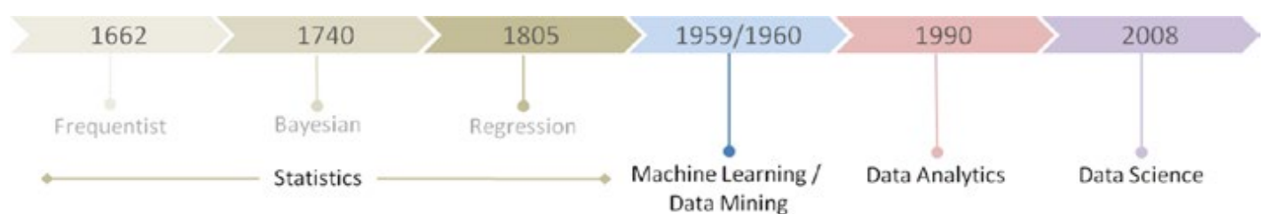
Definition
Predictive Analytics is a sub-branch of the advanced analytics universe which is taken into consideration to make predictions (in maths that means probability) about unknown future events. The kind of methodologies implemented here are Data Mining, Statistics, Data Modelling, Machine Learning and Artificial Intelligence. The idea is to extract the requisite patterns found in historical and transactional data can be used to identify risks and opportunities for future.
Data Mining
Statistics
Data Modelling
Machine Learning
Artificial Intelligence
Notes:
Statistics is the discipline that concerns the collection, organization, analysis, interpretation, and presentation of data.
How Data Mining Works
Data mining involves exploring and analyzing large blocks of information to glean meaningful patterns and trends. It can be used in a variety of ways, such as database marketing, credit risk management, fraud detection, spam Email filtering, or even to discern the sentiment or opinion of users.
Data modeling (data modelling) is the process of creating a data model for the data to be stored in a database. This data model is a conceptual representation of Data objects, the associations between different data objects, and the rules. Data modeling helps in the visual representation of data and enforces business rules, regulatory compliances, and government policies on the data. Data Models ensure consistency in naming conventions, default values, semantics, security while ensuring quality of the data.

Slide 29
Applications of Predictive Analytics
The predictive analytics is being used in an array of industries to solve business problems.
Some of these industries are, as follows:
Marketting: Predictive modeling can use a customer’s purchasing history to inform you of the most effective times to market particular products to that customer.
Banking : By analyzing the helpdesk transcripts, logs and activities, the predictive analytics in banking solution helps in identifying the customer who probably going to leave and look for other service provider.
Quality Assurance: Company involved in transportation, food, distribution services collect the feedback from the customers in order to improve the quality.

Slide 30
Applications of Predictive Analytics
Insurance : The insurance industry relies heavily on data: accident reports, inspections, reimbursement values (repaying a person). This data is critical to make the right decisions, and predictive analytics can be a great tool to make better decisions.
Healthcare : which treatments are most likely to be effective based on that patient’s unique and comprehensive health history.
Real Estate: Predictive analytics allows real estate brokers to provide projected home values to buyers.
Education : Predictive analytics can provide insight into what factors persuade students to stay at your school rather than transfer to another one.
Notes:
The purpose of modelling is to find the best values for the coefficients. Once these values are known, the previous equation is good to predict the output.
Here, the goal is to estimate the values of a and b by fitting the data to this equation. Any supervised algorithm will have an equation or function similar to that of the model above.

Slide 31
Applications of Predictive Analytics
Risk Modelling : If the investments are done in the stock market , then predictive analytics is a better tool to understand the current status and risks involved in the investment.
Sales Forecasting : If historical sales data is available then we can predict about sales in future days.
Notes:
The purpose of modelling is to find the best values for the coefficients. Once these values are known, the previous equation is good to predict the output.
Here, the goal is to estimate the values of a and b by fitting the data to this equation. Any supervised algorithm will have an equation or function similar to that of the model above.

Slide 32
Popular predictive analytics models
Popular predictive analytics models include classification, clustering, and time series models.
Classification models fall under the branch of supervised machine learning models. These models categorize data based on historical data, describing relationships within a given dataset.
For example, this model can be used to classify customers or prospects into groups for segmentation purposes. Alternatively, it can also be used to answer questions with binary outputs, such answering yes or no or true and false;
popular use cases for this are fraud detection and credit risk evaluation.
Types of classification models include logistic regression, decision trees, random forest, neural networks, and Naïve Bayes.
Notes:
The purpose of modelling is to find the best values for the coefficients. Once these values are known, the previous equation is good to predict the output.
Here, the goal is to estimate the values of a and b by fitting the data to this equation. Any supervised algorithm will have an equation or function similar to that of the model above.

Slide 33
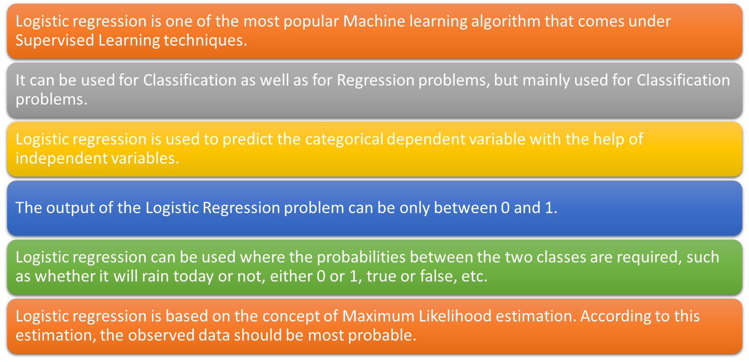
Classification Techniques with Python
Logistic Regression
Notes:
Source: https://www.javatpoint.com/linear-regression-vs-logistic-regression-in-machine-learning
33

Slide 34
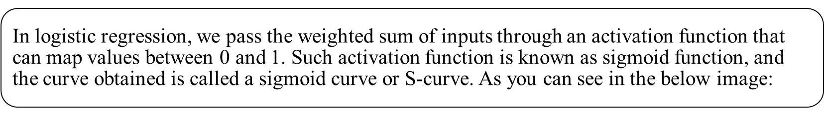


Classification Techniques with Python
Logistic Regression
The equation for logistic regression is:
Y was a continuous variable whose value can range from –infinity to +infinity. The X was either a continuous or a dummy categorical variable and hence it also ranged from –infinity to +infinity.
Notes:
Source: https://www.javatpoint.com/linear-regression-vs-logistic-regression-in-machine-learning
34

Slide 35
Classification Techniques with Python
Logistic Regression
The y ranges from 0 to 1, while X ranges from –infinity to +infinity. What if we replace the P with odds, that is, y/1-y.
Still the LHS of the equation ranges from 0 to +infinity, while the RHS ranges from – infinity to +infinity.
We need to transform one side of the equation so that the ranges on both the sides match. What if we take a natural logarithm of the odds (LHS of the equation)? Then, the range on the LHS also becomes –infinity to +infinity.
The equation for logistic regression is:
Notes:
Source: https://www.javatpoint.com/linear-regression-vs-logistic-regression-in-machine-learning
35

Slide 36
Popular predictive analytics models
Clustering models
Clustering models fall under unsupervised learning.
They group data based on similar attributes. For example, an e-commerce site can use the model to separate customers into similar groups based on common features and develop marketing strategies for each group.
Common clustering algorithms include k-means clustering, mean-shift clustering, density-based spatial clustering of applications with noise (DBSCAN), expectation-maximization (EM) clustering using Gaussian Mixture Models (GMM), and hierarchical clustering.

Slide 37

K means Clustering
Specify the desired number of clusters K : Let us choose k=2 for these 5 data points in 2-D space.
https://www.analyticsvidhya.com/blog/2016/11/an-introduction-to-clustering-and-different-methods-of-clustering/

Slide 38
K means Clustering
2. Randomly assign each data point to a cluster : Let’s assign three points in cluster 1 shown using red color and two points in cluster 2 shown using grey color.

Slide 39
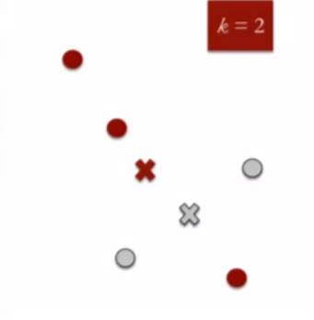
K means Clustering
3. Compute cluster centroids : The centroid of data points in the red cluster is shown using red cross and those in grey cluster using grey cross.

Slide 40
K means Clustering
3. Compute cluster centroids : The centroid of data points in the red cluster is shown using red cross and those in grey cluster using grey cross.

Slide 41
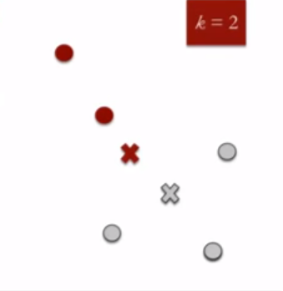
K means Clustering
4. Re-assign each point to the closest cluster centroid : Note that only the data point at the bottom is assigned to the red cluster even though its closer to the centroid of grey cluster. Thus, we assign that data point into grey cluster

Slide 42
K means Clustering
5. Repeat steps 4 and 5 until no improvements are possible : Similarly, we’ll repeat the 4th and 5th steps until we’ll reach global optima.
When there will be no further switching of data points between two clusters for two successive repeats. It will mark the termination of the algorithm if not explicitly mentioned.

Slide 43
K means Clustering
How to choose the value of "K number of clusters" in K-means Clustering?
The performance of the K-means clustering algorithm depends upon highly efficient clusters that it forms. But choosing the optimal number of clusters is a big task.
There are some different ways to find the optimal number of clusters, but here we are discussing the most appropriate method to find the number of clusters or value of K.
https://www.javatpoint.com/k-means-clustering-algorithm-in-machine-learning

Slide 44
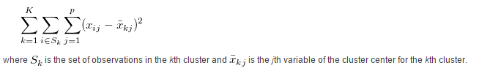
K means Clustering
Elbow Method
The Elbow method is one of the most popular ways to find the optimal number of clusters. This method uses the concept of WCSS value. WCSS stands for Within Cluster Sum of Squares, which defines the total variations within a cluster.
The formula to calculate the value of WCSS (for 3 clusters) is given below:
https://www.javatpoint.com/k-means-clustering-algorithm-in-machine-learning

Slide 45
K means Clustering
To find the optimal value of clusters, the elbow method follows the below steps:
It executes the K-means clustering on a given dataset for different K values (ranges from 1-10).
For each value of K, calculates the WCSS value.
Plots a curve between calculated WCSS values and the number of clusters K.
The sharp point of bend or a point of the plot looks like an arm, then that point is considered as the best value of K.
https://www.javatpoint.com/k-means-clustering-algorithm-in-machine-learning

Slide 46
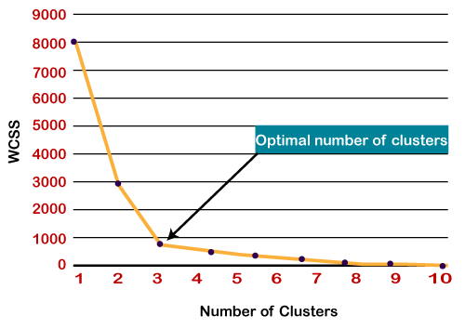
K means Clustering
Since the graph shows the sharp bend, which looks like an elbow, hence it is known as the elbow method.
https://www.javatpoint.com/k-means-clustering-algorithm-in-machine-learning

Slide 47
Hierarchical Clustering
A Hierarchical clustering method works via grouping data into a tree of clusters.
Hierarchical clustering begins by treating every data points as a separate cluster. Then, it repeatedly executes the subsequent steps:
Identify the 2 clusters which can be closest together, and
Merge the 2 maximum comparable clusters. We need to continue these steps until all the clusters are merged together.
.
https://www.geeksforgeeks.org/hierarchical-clustering-in-data-mining/

Slide 48
Hierarchical Clustering
In Hierarchical Clustering, the aim is to produce a hierarchical series of nested clusters. A diagram called Dendrogram.
It graphically represents this hierarchy and is an inverted tree that describes the order in which factors are merged (bottom-up view) or cluster are break up (top-down view).
.
https://www.geeksforgeeks.org/hierarchical-clustering-in-data-mining/

Slide 49
Hierarchical Clustering
Agglomerative: Initially consider every data point as an individual Cluster and at every step, merge the nearest pairs of the cluster. (It is a bottom-up method). At first every data set is considered as individual entity or cluster. At every iteration, the clusters merge with different clusters until one cluster is formed.
Algorithm for Agglomerative Hierarchical Clustering is:
Calculate the similarity of one cluster with all the other clusters (calculate proximity matrix)
Consider every data point as a individual cluster.
Merge the clusters which are highly similar or close to each other.
Recalculate the proximity matrix for each cluster.
Repeat Step 3 and 4 until only a single cluster remains.
.
https://www.geeksforgeeks.org/hierarchical-clustering-in-data-mining/

Slide 50
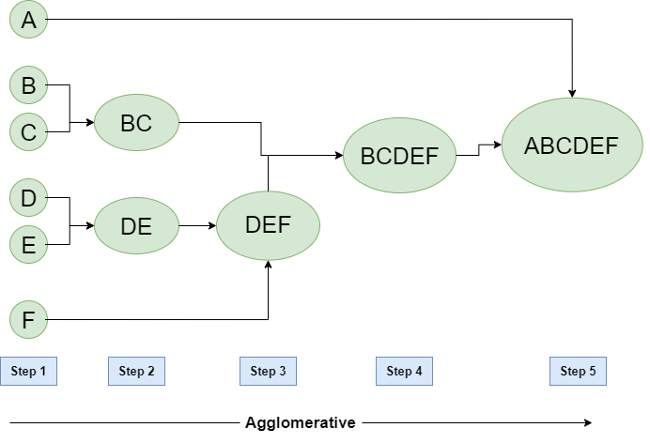
Hierarchical Clustering
Let’s say we have six data points A, B, C, D, E, F.
.
https://www.geeksforgeeks.org/hierarchical-clustering-in-data-mining/

Slide 51
Hierarchical Clustering
Step-1:
Consider each alphabet as a single cluster and calculate the distance of one cluster from all the other clusters.
Step-2:
In the second step comparable clusters are merged together to form a single cluster. Let’s say cluster (B) and cluster (C) are very similar to each other therefore we merge them in the second step similarly with cluster (D) and (E) and at last, we get the clusters
[(A), (BC), (DE), (F)]
Step-3:
We recalculate the proximity according to the algorithm and merge the two nearest clusters ([(DE), (F)]) together to form new clusters as [(A), (BC), (DEF)]
Step-4:
Repeating the same process; The clusters DEF and BC are comparable and merged together to form a new cluster. We’re now left with clusters [(A), (BCDEF)].
Step-5:
At last the two remaining clusters are merged together to form a single cluster [(ABCDEF)].
https://www.geeksforgeeks.org/hierarchical-clustering-in-data-mining/

Slide 52
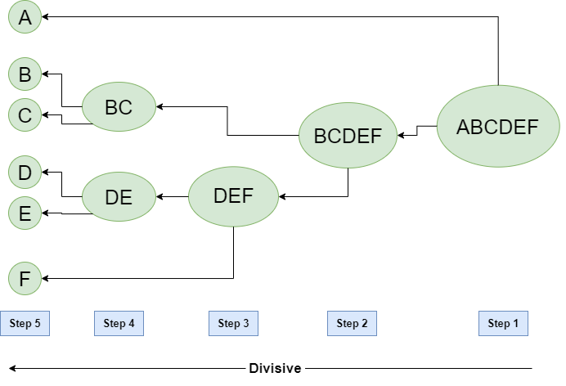
Hierarchical Clustering
2. Divisive:
We can say that the Divisive Hierarchical clustering is precisely the opposite of the Agglomerative Hierarchical clustering.
In Divisive Hierarchical clustering, we take into account all of the data points as a single cluster and in every iteration, we separate the data points from the clusters which aren’t comparable. In the end, we are left with N clusters.
https://www.geeksforgeeks.org/hierarchical-clustering-in-data-mining/

Slide 53
Hierarchical Clustering
Strengths of Hierarchical Clustering
It is easy to understand and implement.
We donot have to pre-specify any particular number of clusters.
Can obtain any desired number of clusters by cutting the Dendrogram at the proper level.
They may correspond to meaningful classification.
Easy to decide the number of clusters by merely looking at the Dendrogram.
https://www.geeksforgeeks.org/hierarchical-clustering-in-data-mining/

Slide 54
Hierarchical Clustering
Limitations of Hierarchical Clustering
Hierarchical Clustering does not work well on vast amounts of data.
All the approaches to calculate the similarity between clusters have their own disadvantages.
In hierarchical Clustering, once a decision is made to combine two clusters, it can not be undone.
Different measures have problems with one or more of the following.
Sensitivity to noise and outliers.
Faces Difficulty when handling with different sizes of clusters.
It is breaking large clusters.
In this technique, the order of the data has an impact on the final results.
https://www.geeksforgeeks.org/hierarchical-clustering-in-data-mining/

Slide 55
Popular predictive analytics models
Time series models
Time series models use various data inputs at a specific time frequency, such as daily, weekly, monthly.
It is common to plot the dependent variable over time to assess the data for seasonality, trends, and cyclical behavior, which may indicate the need for specific transformations and model types.
Autoregressive (AR), moving average (MA), ARMA, and ARIMA models are all frequently used time series models. As an example, a call center can use a time series model to forecast how many calls it will receive per hour at different times of day.

Slide 56
Data Patterns
Horizontal
When there is no trend in the data pattern, we deal with horizontal data pattern.
Forecast Variable
Mean
Time

Slide 57
Data Patterns
Trend
Long-term growth movement of a time series
Y_{t}
Trend
Y_{t}
Trend
t
t
Y_{t}
Trend
Y_{t}
Trend
t
t

Slide 58
Data Patterns
Seasonal Pattern
A predictable and repetitive movement observed around a trend line within a period of 1 year or less.
Forecast Variable
Time

Slide 59
Data Patterns
Cyclical
Occurs with business and economic expansions and contractions.
Lasts longer than 1 year.
Correlated with business cycles.

Slide 60
Time series patterns
In describing these time series, we have used words such as “trend” and “seasonal” which need to be defined more carefully.
Trend
A trend exists when there is a long-term increase or decrease in the data. It does not have to be linear. Sometimes we will refer to a trend as “changing direction”, when it might go from an increasing trend to a decreasing trend.
Seasonal
A seasonal pattern occurs when a time series is affected by seasonal factors such as the time of the year or the day of the week. Seasonality is always of a fixed and known frequency. The monthly sales of antidiabetic drugs above shows seasonality which is induced partly by the change in the cost of the drugs at the end of the calendar year.

Slide 61
Cyclic
A cycle occurs when the data exhibit rises and falls that are not of a fixed frequency. These fluctuations are usually due to economic conditions and are often related to the “business cycle”. The duration of these fluctuations is usually at least 2 years.
Many people confuse cyclic behavior with seasonal behavior, but they are really quite different. If the fluctuations are not of a fixed frequency then they are cyclic; if the frequency is unchanging and associated with some aspect of the calendar, then the pattern is seasonal. In general, the average length of cycles is longer than the length of a seasonal pattern, and the magnitudes of cycles tend to be more variable than the magnitudes of seasonal patterns.
Many time series include trend, cycles and seasonality. When choosing a forecasting method, we will first need to identify the time series patterns in the data, and then choose a method that is able to capture the patterns properly.

Slide 62
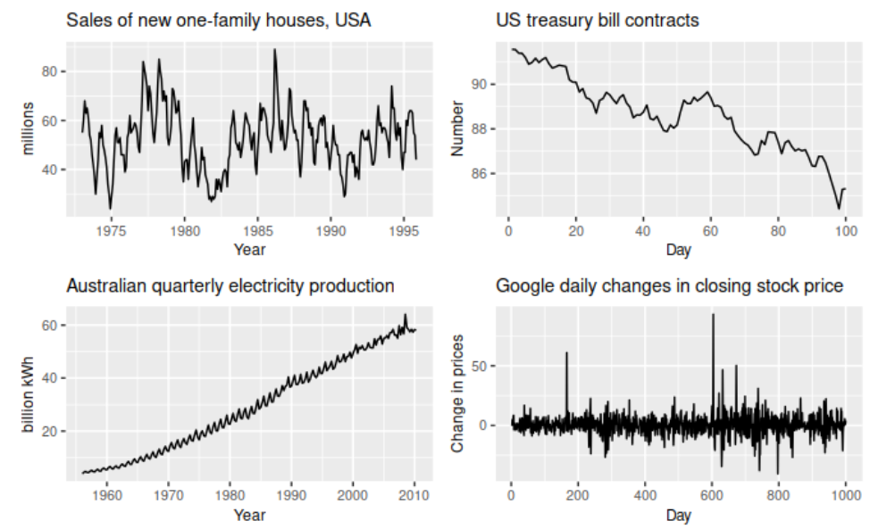
Four examples of time series showing different patterns.

Slide 63
The monthly housing sales (top left) show strong seasonality within each year, as well as some strong cyclic behavior with a period of about 6–10 years. There is no apparent trend in the data over this period.
The US treasury bill contracts (top right) show results from the Chicago market for 100 consecutive trading days in 1981. Here there is no seasonality, but an obvious downward trend. Possibly, if we had a much longer series, we would see that this downward trend is actually part of a long cycle, but when viewed over only 100 days it appears to be a trend.
The Australian quarterly electricity production (bottom left) shows a strong increasing trend, with strong seasonality. There is no evidence of any cyclic behavior here.
The daily change in the Google closing stock price (bottom right) has no trend, seasonality or cyclic behavior. There are random fluctuations which do not appear to be very predictable, and no strong patterns that would help with developing a forecasting model.

Slide 64
Time Series Model
What Is a Moving Average (MA)?
In finance, a moving average (MA) is a stock indicator commonly used in technical analysis. The reason for calculating the moving average of a stock is to help smooth out the price data by creating a constantly updated average price.

Slide 65
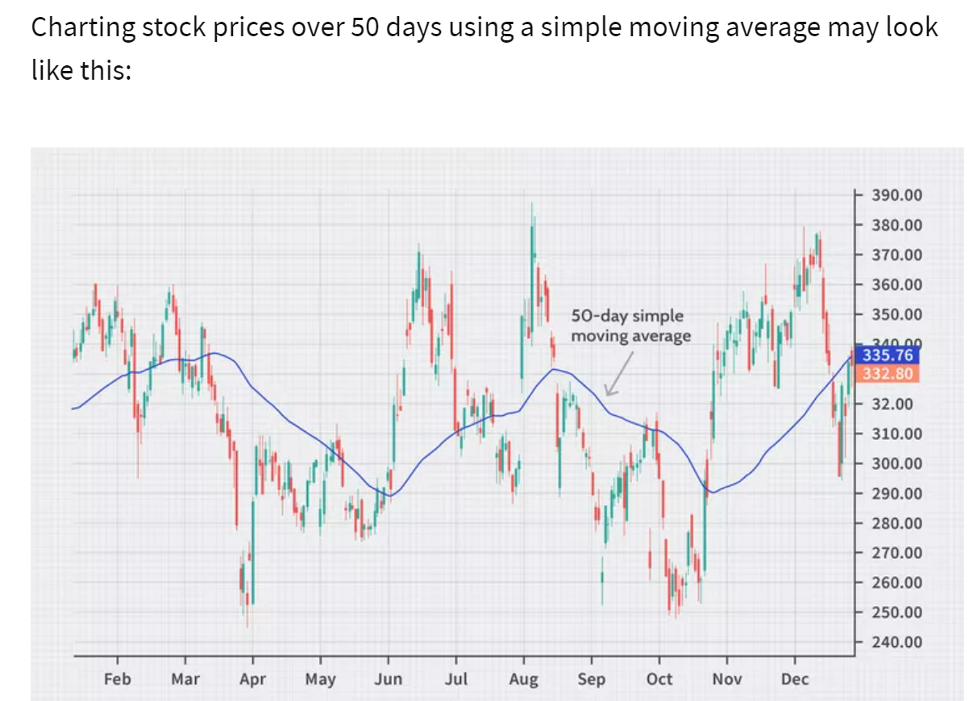
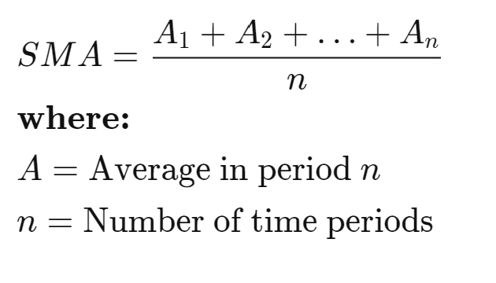
Types of Moving Averages
Simple Moving Average
A simple moving average (SMA), is calculated by taking the arithmetic mean of a given set of values over a specified period. A set of numbers, or prices of stocks, are added together and then divided by the number of prices in the set. The formula for calculating the simple moving average of a security is as follows:

Slide 66
Exponential Smoothing Methods
This method provides an exponentially weighted moving average of all previously observed values.
Appropriate for data with no predictable upward or downward trend.
The aim is to estimate the current level and use it as a forecast of future value.
Notes:
This is an obvious extension the moving average method. With simple moving average forecasts the mean of the past k observations used as a forecast have equal eights (1/k) for all k data points. With exponential smoothing the idea is that the most recent observations will usually provide the best guide as to the future, so we want a weighting scheme that has decreasing weights as the observations get older

Slide 67
Simple Exponential Smoothing Method
Formally, the exponential smoothing equation is
forecast for the next period.
α = smoothing constant.
y_{t} = observed value of series in period t.
= old forecast for period t.
The forecast F_{t+1} is based on weighting the most recent observation y_{t} with a weight α and weighting the most recent forecast F_{t} with a weight of 1- α

Slide 68
Simple Exponential Smoothing Method
The implication of exponential smoothing can be better seen if the previous equation is expanded by replacing F_{t} with its components as follows:

Slide 69
Simple Exponential Smoothing Method
If this substitution process is repeated by replacing F_{t-1} by its components, F_{t-2} by its components, and so on the result is:
Therefore, F_{t+1} is the weighted moving average of all past observations.

Slide 70
Simple Exponential Smoothing Method
The following table shows the weights assigned to past observations for α = 0.2, 0.4, 0.6, 0.8, 0.9

Slide 71
Simple Exponential Smoothing Method
The exponential smoothing equation rewritten in the following form elucidate the role of weighting factor α.
Exponential smoothing forecast is the old forecast plus an adjustment for the error that occurred in the last forecast.

Slide 72
Simple Exponential Smoothing Method
The value of smoothing constant α must be between 0 and 1
α can not be equal to 0 or 1.
If stable predictions with smoothed random variation is desired then a small value of α is desire.
If a rapid response to a real change in the pattern of observations is desired, a large value of α is appropriate.

Slide 73
Simple Exponential Smoothing Method
To estimate α, Forecasts are computed for α equal to .1, .2, .3, …, .9 and the sum of squared forecast error is computed for each.
The value of α with the smallest RMSE is chosen for use in producing the future forecasts.

Slide 74
Simple Exponential Smoothing Method
To start the algorithm, we need F₁ because
Since F₁ is not known, we can
Set the first estimate equal to the first observation.
Use the average of the first five or six observations for the initial smoothed value.

Slide 75
Example:University of Michigan Index of Consumer Sentiment
University of Michigan Index of Consumer Sentiment for January1995- December1996.
we want to forecast the University of Michigan Index of Consumer Sentiment using Simple Exponential Smoothing Method.

Slide 76
Example:University of Michigan Index of Consumer Sentiment
Since no forecast is available for the first period, we will set the first estimate equal to the first observation.
We try α =0.3, and 0.6.

Slide 77
Example:University of Michigan Index of Consumer Sentiment
Note the first forecast is the first observed value.
The forecast for Feb. 95 (t = 2) and Mar. 95 (t = 3) are evaluated as follows:

Slide 78
Example:University of Michigan Index of Consumer Sentiment
RMSE =2.66 for α = 0.6
RMSE =2.96 for α = 0.3

Slide 79
Open source technology for Big Data Analytics
Open-source big data analytics services encompass:
Data collection system
Control center for administering and monitoring clusters
Machine learning and data mining library
Application coordination service
Compute engine
Execution framework
Different Types of Open-source technology for big data analytics are:
Apache Spark
R
Hadoop
Rapid Miner
Pentaho
https://www.mastersindatascience.org/resources/open-source-tools-for-big-data-analysis/
https://www.selecthub.com/big-data-analytics/open-source-big-data-analytics-software/

Slide 80
Open source technology for Big Data Analytics
Benefits of Open-source big data analytics services encompass:
Collaboration and Community
Many mainstream open source software products are propped up by hundreds, maybe thousands of contributors.
Customizable
Access to the source code means the software can be tailored to the specific needs of a user or business. Code can be added or deleted, removing unnecessary pieces that would bog down an entity’s limited resources.
Cost Effective and Nonbinding
While open source doesn’t necessarily mean free, it does often mean cost reduction. If an open source license is indeed free of charge, instead of paying for everything, users just pay for auxiliary components, not the software.
https://www.selecthub.com/big-data-analytics/open-source-big-data-analytics-software/

Slide 81
Open source technology for Big Data Analytics
Hadoop
Apache Hadoop is an assortment of open source software for distributed and parallelized computing, specifically for the task of analyzing and processing large data sets. The core of Apache Hadoop consists of a storage part, known as Hadoop Distributed File System (HDFS), and a processing part called MapReduce. It allows multiple computers to distribute file storage (also known as “Clustered File System”) and process big data by utilizing the MapReduce algorithm.
HDFS is a distributed, scalable and portable file system written in Java for the Hadoop framework.
YARN manages computing resources in clusters and uses them to schedule users’ applications. The fundamental idea of YARN is to split up the functionalities of resource management and job scheduling/monitoring into separate daemons (programs that run in the background). The idea is to have a global ResourceManager (RM) and per-application ApplicationMaster (AM).
Hive is a platform used to develop SQL TypeScripts to do MapReduce operations. Hive enables analysis of large data sets using a language very similar to standard ANSI SQL. This means anyone who can write SQL queries can access data stored on the Hadoop cluster. Hive offers a simple interface for log processing, text mining, document indexing, customer-facing business intelligence (e.g., Google Analytics), predictive modeling and hypothesis testing.

Slide 82
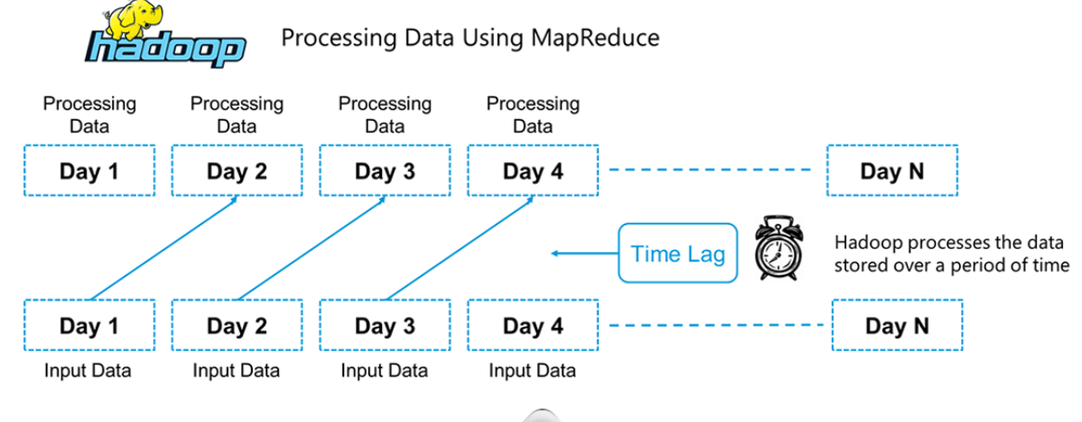
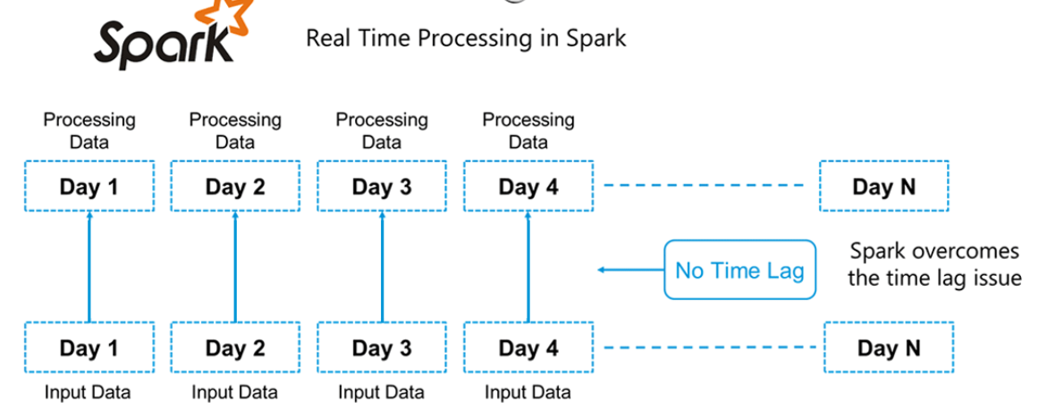
Apache Spark
Hadoop is based on batch processing of big data. This means that the data is stored over a period of time and is then processed using Hadoop.
Whereas in Spark, processing can take place in real-time. This real-time processing power in Spark helps us to solve the use cases of Real Time Analytics

Slide 83
Apache Spark
Hadoop components can be used alongside Spark in the following ways:
HDFS: Spark can run on top of HDFS to leverage the distributed replicated storage.
MapReduce: Spark can be used along with MapReduce in the same Hadoop cluster or separately as a processing framework.
YARN: Spark applications can be made to run on YARN (Hadoop NextGen).
Batch & Real Time Processing: MapReduce and Spark are used together where MapReduce is used for batch processing and Spark for real-time processing.
https://www.edureka.co/blog/spark-tutorial/
https://intellipaat.com/blog/tutorial/spark-tutorial/

Slide 84
Apache Spark
Apache Spark has following features.
Speed − Spark helps to run an application in Hadoop cluster, up to 100 times faster in memory, and 10 times faster when running on disk. This is possible by reducing number of read/write operations to disk. It stores the intermediate processing data in memory.
Supports multiple languages − Spark provides built-in APIs in Java, Scala, or Python. Therefore, you can write applications in different languages. Spark comes up with 80 high-level operators for interactive querying.
Advanced Analytics − Spark not only supports ‘Map’ and ‘reduce’. It also supports SQL queries, Streaming data, Machine learning (ML), and Graph algorithms.

Slide 85
Apache Spark
Polyglot:
Spark provides high-level APIs in Java, Scala, Python and R. Spark code can be written in any of these four languages. It provides a shell in Scala and Python. The Scala shell can be accessed through ./bin/spark-shell and Python shell through ./bin/pyspark from the installed directory.
Multiple Formats:
Spark supports multiple data sources such as Parquet, JSON, Hive and Cassandra apart from the usual formats such as text files, CSV and RDBMS tables. The Data Source API provides a pluggable mechanism for accessing structured data though Spark SQL.
Lazy Evaluation:
Apache Spark delays its evaluation till it is absolutely necessary. This is one of the key factors contributing to its speed. For transformations, Spark adds them to a DAG (Directed Acyclic Graph) of computation and only when the driver requests some data, does this DAG actually gets executed.

Slide 86
R
R is a free software programming language for statistical computing, data analysis and data visualizations. It also has its own software environment and a built-in command line interface, although many users tend to use.
R is very common among statisticians (it is described as being developed by statisticians for statisticians) and is widely used in academic settings. Just like any other programming language, R’s capabilities can be expanded by installing different libraries, thus allowing big data analysis capabilities.
Some of these packages are:
(Programming with Big Data in R) is a series of R packages for data analysis and statistical programming for big data. pdbR uses distributed systems, meaning data are split across different systems/computers, and allows for processing very large data sets.
MapReduce library in R: As the name implies, this package allows users to utilize the MapReduce algorithm in R.
The “SparkR” can be used as a front end for Apache Spark in R.

Slide 87
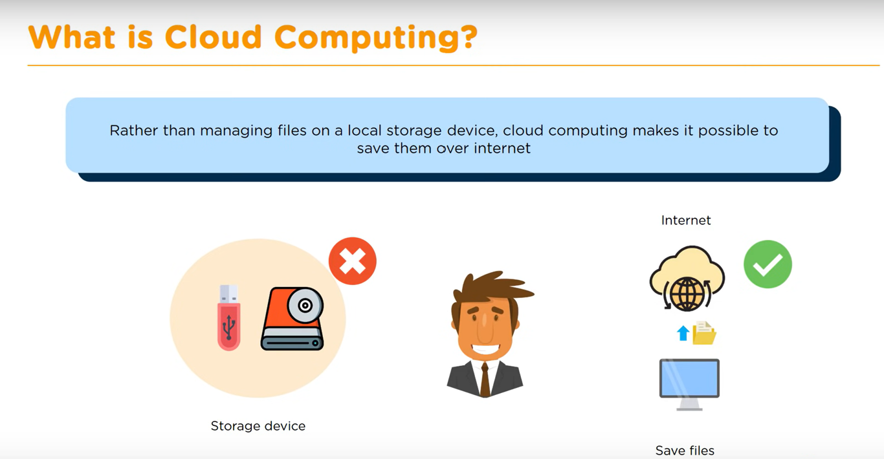
Cloud computing
Cloud computing stands for storing and accessing data and programs over the internet, rather than on your computer’s hard drive. For it to be considered ‘cloud computing’, you need to access your data or your programs over the internet, or have that data synced with other information over the web.
Cloud computing allows organization to significantly exceed the normal available storage, without having to host extra servers on site. Data can also be collected from multiple sites and devices, accessible anytime, anywhere.

Slide 88
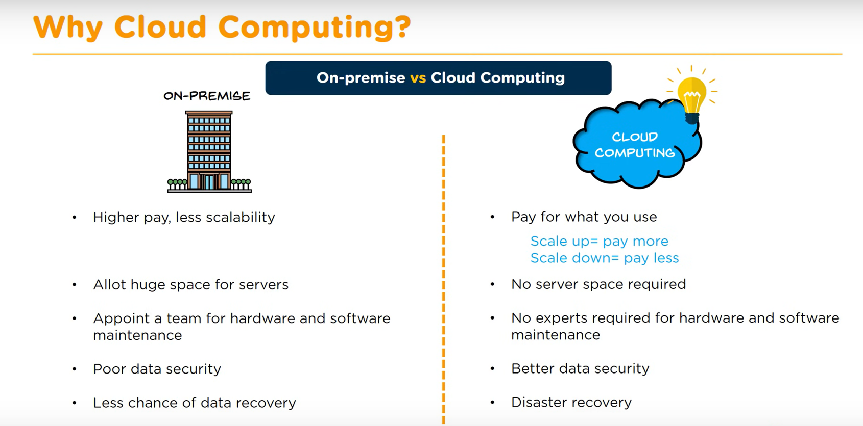

Slide 89
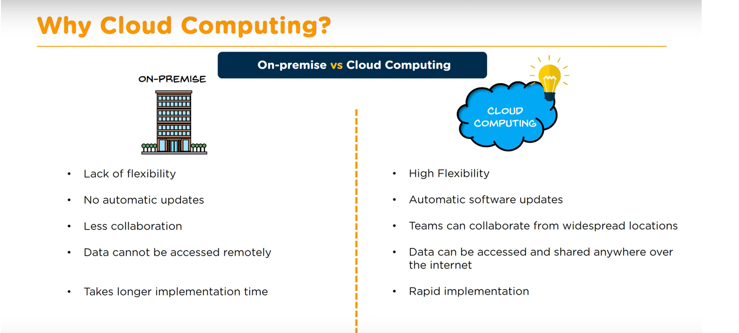

Slide 90
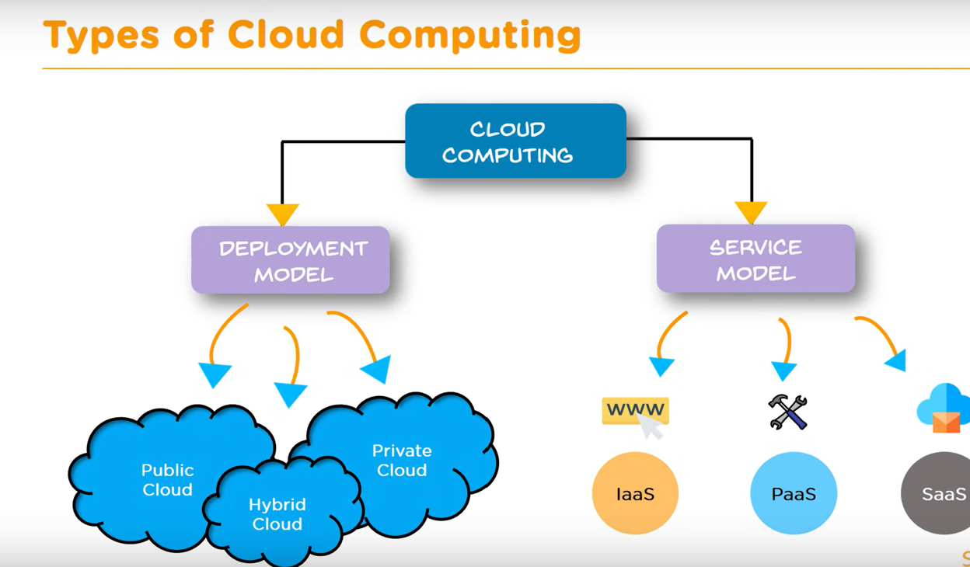

Slide 91
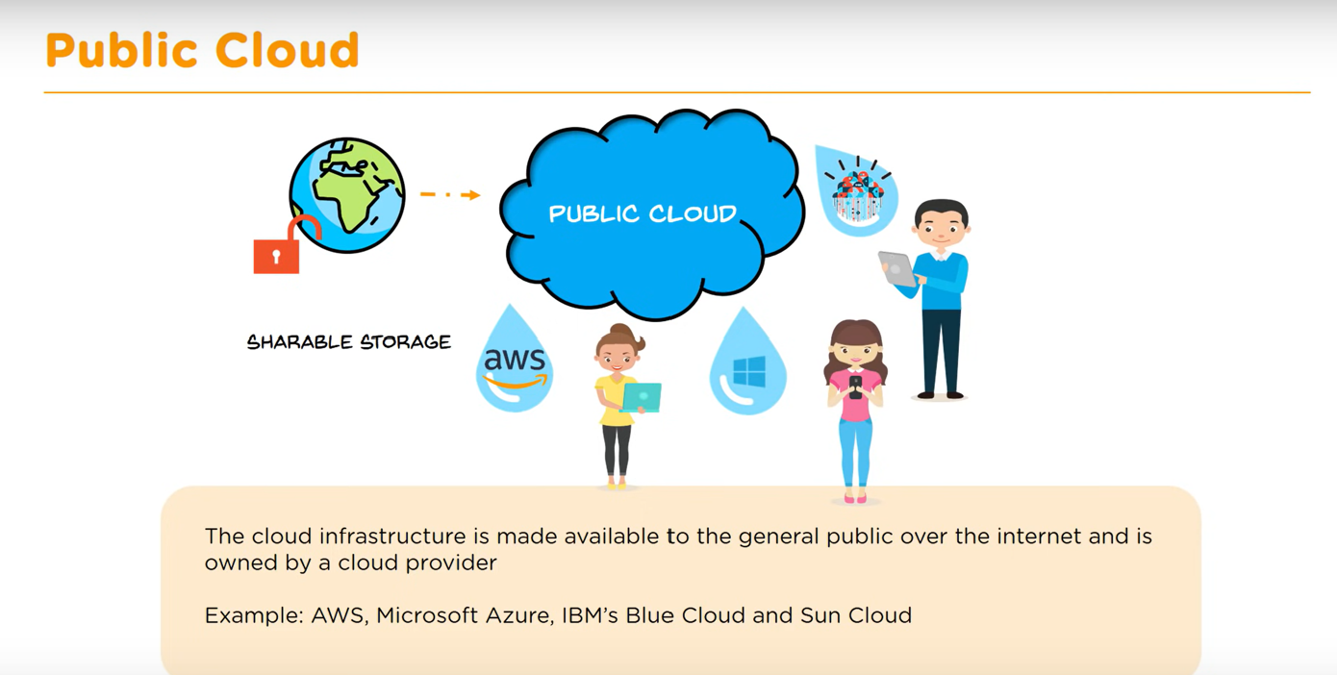

Slide 92
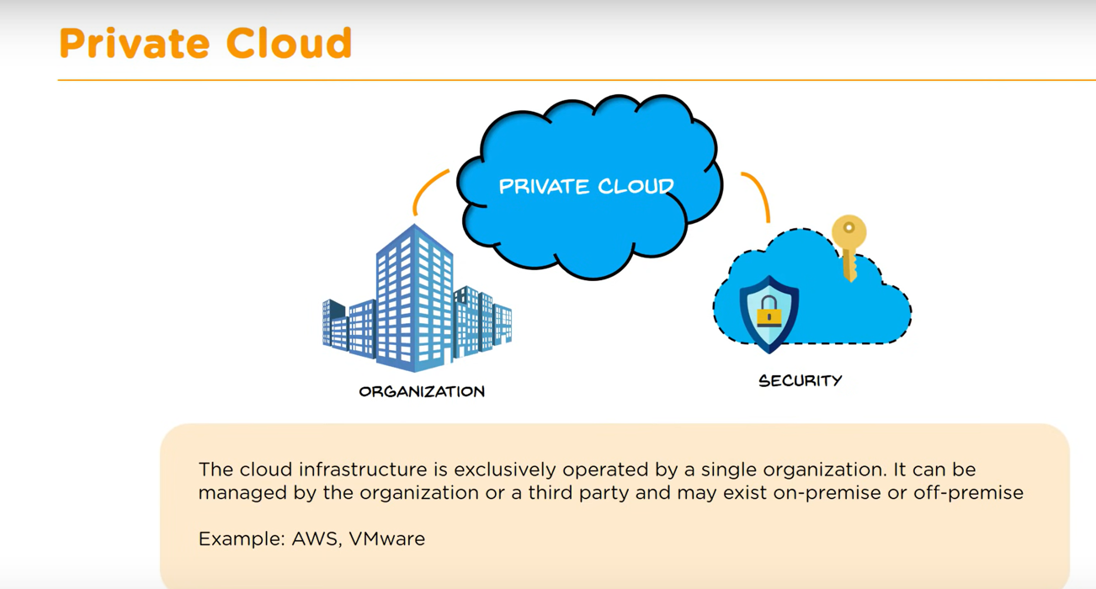

Slide 93
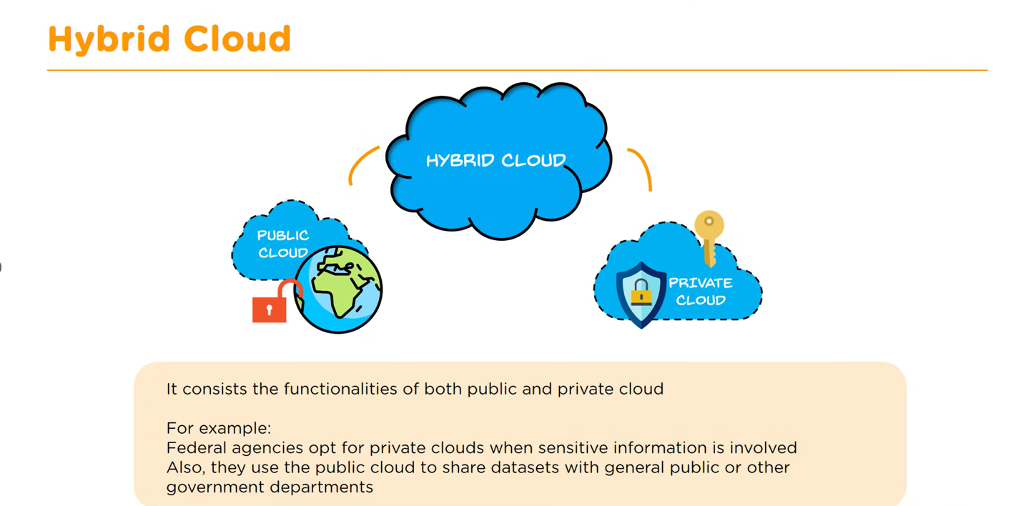

Slide 94
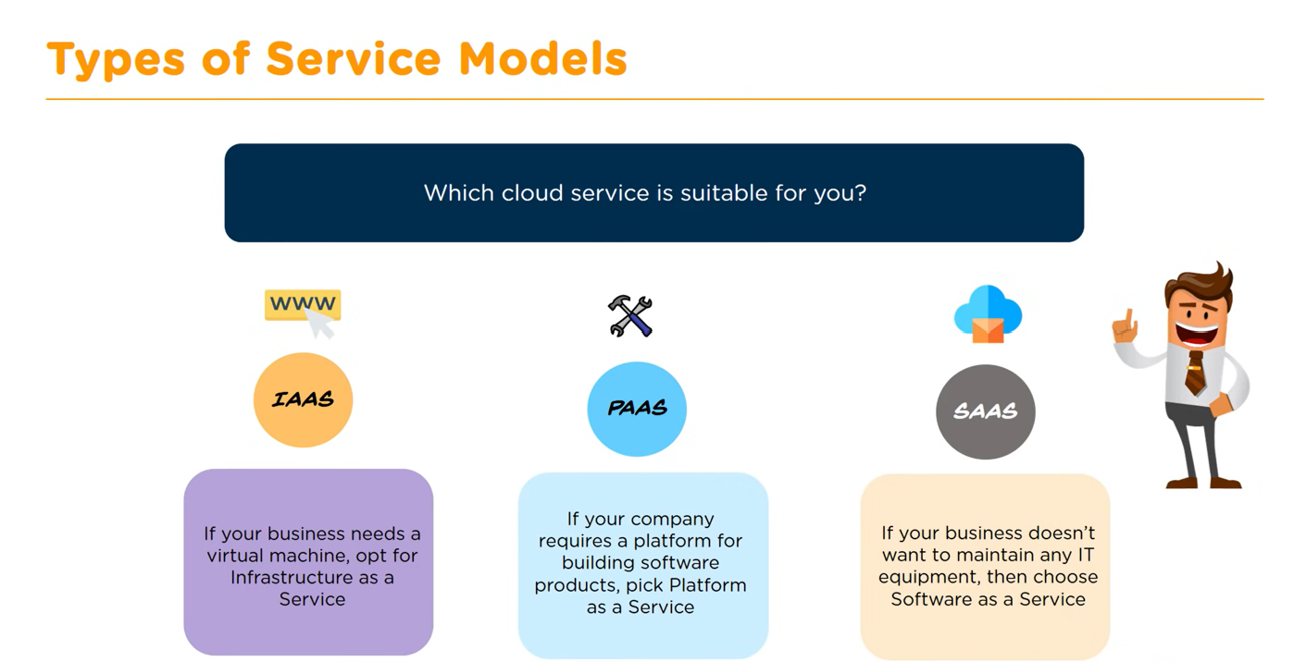

Slide 95
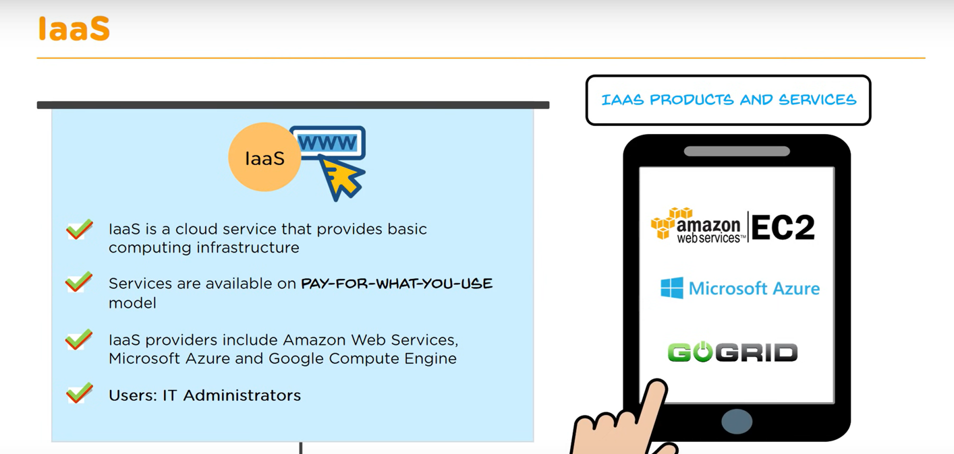

Slide 96
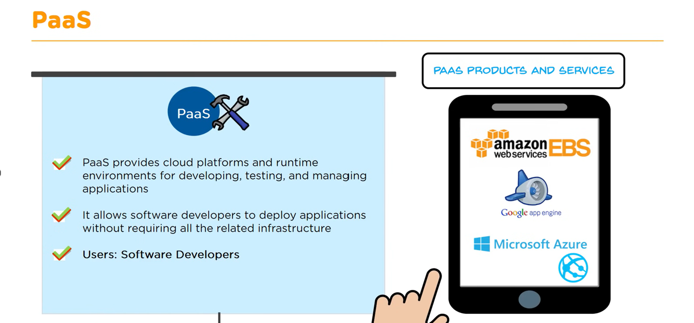

Slide 97
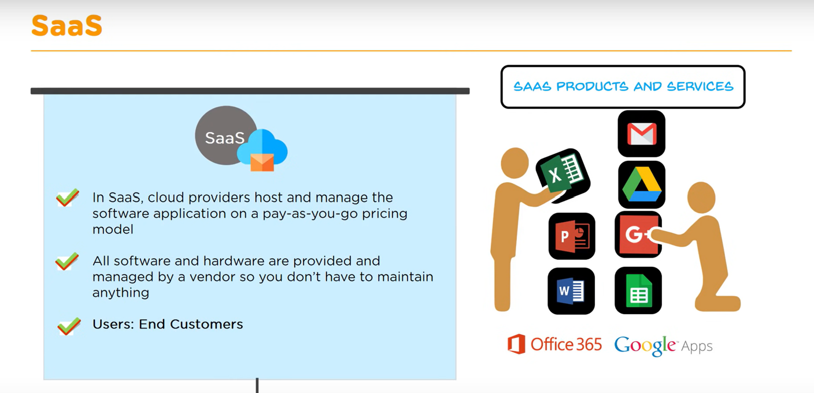

Slide 98
Characteristics of Cloud Infrastructure
On-demand self-service: Able to access servers and storage without interacting with someone.
Broad network access: Cloud resources are accessible over the internet (if enabled) by various methods, such as web browser or mobile phone.
Resource pooling: Resources, both physical and virtual, are dynamically assigned and reassigned as needed. The specific location of resources is unknown and generally unimportant. According to requirement resource can be allocated, reallocated and deallocated.
Rapid elasticity: Resources can be elastically created and destroyed according to demand. The supply of resources is effectively unlimited from user viewpoint.
Measured service: The resource usage is monitored, controlled, and reported by the cloud provider. You have access to the same information, providing transparency to your utilization. Cloud systems continuously optimize resources automatically.

Slide 99
The advantages of cloud are:
Speed: Within minutes you can access your resources online through cloud.
Agility: The ability to quickly create and destroy resources leads to ease of experimentation. This increases the agility of analytics organizations.
Variety of services: Cloud providers have many services available to support analytics workflows that can be deployed within minutes. These services manage hardware and storage needs for you. Ex- public, hybrid, SaaS, PaaS etc.
Global reach: You can extend the reach of analytics to the other side of the world with a few clicks.
Cost control: You only pay for the resources you need at the time you need them. You can do more for less.
Notes:
What is SaaS? Software as a service (or SaaS) is a way of delivering applications over the Internet—as a service. Instead of installing and maintaining software, you simply access it via the Internet,
Platform as a service (PaaS) is a complete development and deployment environment in the cloud, with resources that enable you to deliver everything from simple cloud-based apps to sophisticated, cloud-enabled enterprise applications.

Slide 100
The Amazon Web Services (AWS) overview:
AWS offers various services from networking to computation.
Three main services needed to be configured properly to support analytics: networking, computing, and storing.
Networking includes security and handles communication routing. The service need to be able to communicate to each other.
Computing handles processing, calculations, and running applications.
Storage includes where you keep the input data and output results of your analytics.

Slide 101
AWS key concepts
These include Regions, Availability Zones, subnets, and security groups.
Regions: Regions are the major division in AWS and correspond to general data center geographic location areas.
Availability Zones: Within Regions, there are multiple Availability Zones. The number depends on the Region. These are physically separate locations but are closely linked to each other. Communication between Availability Zones is simple to configure.

Slide 102
Subnets: Subnets are divisions of your network, represented by IP ranges. Subnets are created within an Availability Zone. Resources are launched into a subnet and can talk to other resources in the same subnet. Communication outside subnets needs to be defined.
Security groups: It defines the network traffic that is allowed in and out. One or more resources can belong to a group. Server instances, databases, and cluster nodes all require them. They block everything by default, so you must specify the traffic to allow.

Slide 103
AWS divisions
Subnet
Availability Zones
Region

Slide 104
AWS key core services
Virtual Private Cloud (VPC): A VPC is, logically isolated part of the AWS Cloud. Here you can create and configure your own defined network. Consider this as a self-contained environment in which your analytics live. You have full control here. You can create and configure your own IP address ranges, subnets, network gateways, and routing tables.
Identity and Access Management (IAM): This is where users are defined (IAM users), access key pairs are created, and security roles are defined (IAM roles). IAM provide a simple and secure way for your instances to communicate with other AWS services. Assigning this when creating a resource natively grants permissions to the service defined by the role. This is done without storing access keys on the server instance. This means that even if the server is compromised, the breachers will not have the key for access.

Slide 105
Applying big data technology to storage
Hadoop
Parquet
Avro
Hive
Amazon DynamoDB
Amazon S3

Slide 106
Applying big data technology to storage
Elastic Compute Cloud (EC2): EC2 allows you to create virtual servers (called instances). It defines the virtual hardware configuration (think CPU/RAM combination) and amount of memory. Within few minutes it will be ready and running. It helps to maintain application availability and can automatically add or remove EC2 instances according to defined criteria.
Simple Storage Service (S3): Amazon Simple Storage Service (Amazon S3) is an object storage service that offers industry-leading scalability, data availability, security, and performance. S3 is an object-based storage service. Scaling and redundancy are handled automatically. Multiple copies of files are automatically created across multiple devices and locations.

Slide 107
Amazon Relational Database Service (RDS): RDS is a set of managed relational databases that includes database engines such as Oracle. Microsoft SQL Server, PostgreSQL, MySQL, and MariaDB. you have full control over it. You can access the database, but not the underlying server where it is hosted. This part also provides monitoring of the status of the database management system.
Amazon Redshift: Redshift is a fully managed, SQL-compliant data warehouse service. A Redshift cluster can store up to 1 petabyte. It has its own JDBC and ODBC drivers, but also supports Standard PostgreSQL driver. This means that most business intelligence (BI) tools can connect directly. Redshift is useful for frequently queried data and is a popular place to provide processed and aggregated IoT data for use by the wider enterprise.
*JDBC=Java Database Connectivity
**ODBC= Open Database Connectivity

Slide 108
Microsoft Azure overview
Microsoft offers a cloud infrastructure service called Azure that competes directly with AWS. Integration leans more toward Microsoft technology, such as the Windows operating system, the .NET programming language, and the SQL Server database.
Azure Data Lake Store: Azure Data Lake Store is compatible with Hadoop Distributed File System (HDFS). It also has a REST interface for applications that is WebHDFS-compatible. Data stored in Data Lake Store can be analyzed using analytic frameworks within the Hadoop ecosystem, such as MapReduce and Hive.

